Slide 1
BREAK THE ICE
Student-approved questions to learn more about who they are

Slide 2
Use these questions with your students to spark thinking, encourage interaction, and help them gain empathy for each other.

Slide 3
What is the last movie or show you told a friend about?

Slide 4
What’s something you’re passionate about?

Slide 5
What’s a topic you know well enough to teach a class?

Slide 6
What is a song you have played on repeat?

Slide 7
What’s the best piece of advice you’ve ever received?

Slide 8
What would you do for fun if you didn’t have the internet?

Slide 9
Who is your favorite personality or brand on social media and why?

Slide 10
What do you usually do on the weekends?

Slide 11
If you could have any job in the world for a day, what would it be and why?

Slide 12
If you were a board game, which would you be?

Slide 13
What is your favorite way to unwind?

Slide 14
Would you rather visit 100 years in the past or 100 years in the future? Why?

Slide 15
Do you prefer cold weather or hot weather and why?

Slide 16
Are you a night owl or an early bird?

Slide 17
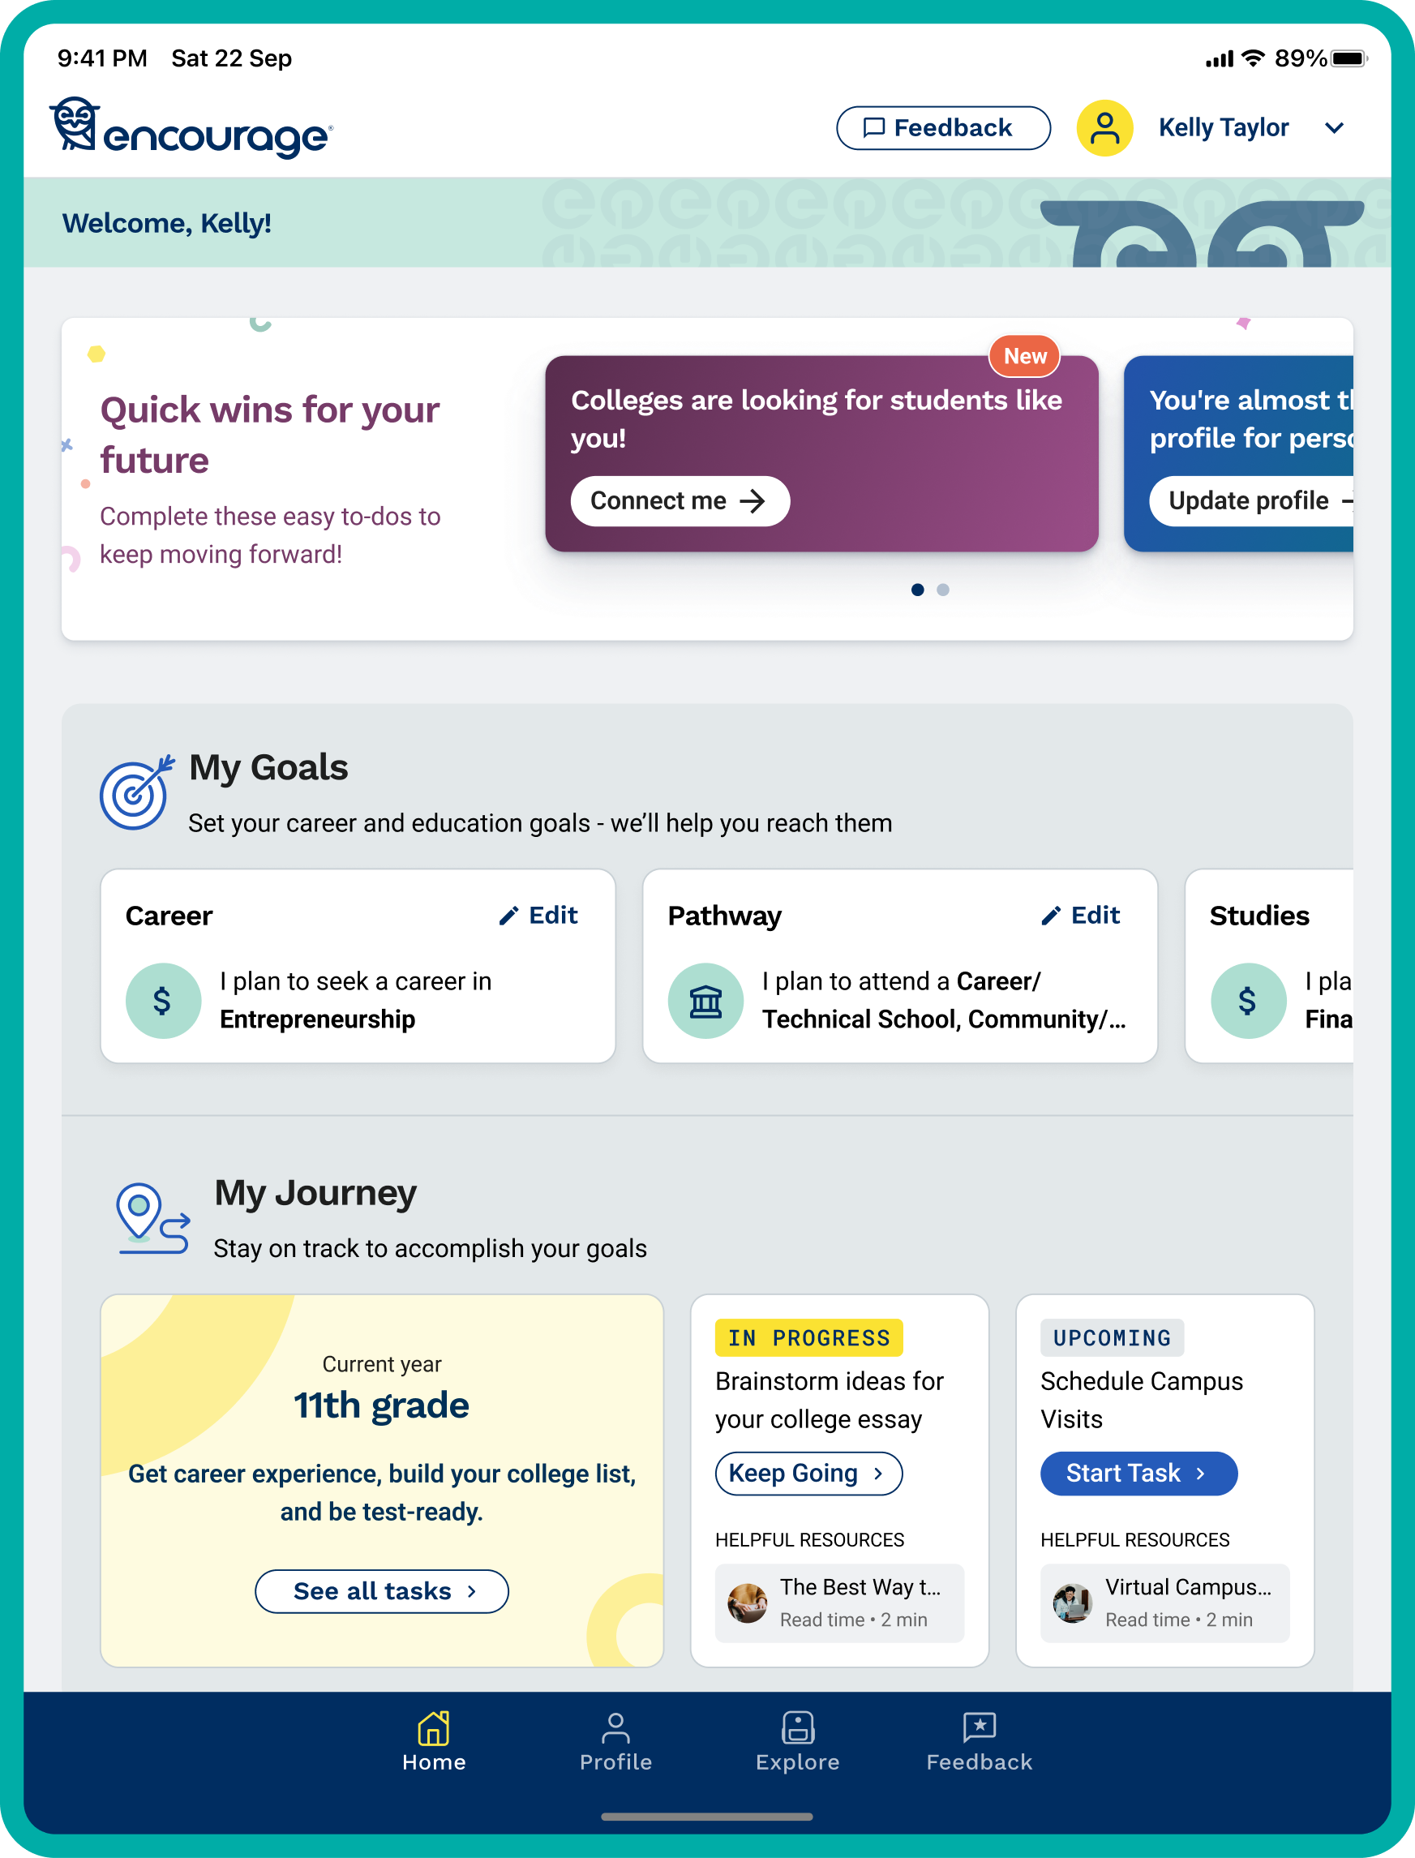
Encourage is a free, easy-to-use college and career planning program for grades 7–12.
It helps educators bring structure and purpose to future planning efforts—empowering every student to see what’s possible and understand the steps to get there.
encourageme.com/educators

