Slide 1
National Entpreneurship Month
In the chat, share the emoji that represents how your fall is going so far, your name, and your state
🥳🥴🤪😵‍💫🫨
November 4, 2025

Slide 2

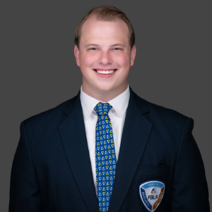
Welcome to National Entrepreneurship
Month
Yasha
Jonathan
Nagathan
Nevenhoven
HS FBLA
Collegiate FBLA
National President
National President

Slide 3
This Evening’s Agenda
Why National Entrepreneurship Month Matters
Young Entrepreneurs Panel
Entrepreneurship Month Toolkit
American Enterprise Day
Shop Local Campaign

Slide 4
Why National Entrepreneurship Month Matters
Encourage innovation and entrepreneurship at all levels—from
students to startups and established businesses.
Highlight the role of entrepreneurs in creating jobs, driving growth, and solving community challenges.
Educate students and communities about business fundamentals, leadership, and entrepreneurial skills.
Inspire individuals to transform ideas into ventures and pursue creative, impactful solutions.

Slide 5
Welcome
Young Entrepreneurs Panel

Slide 6

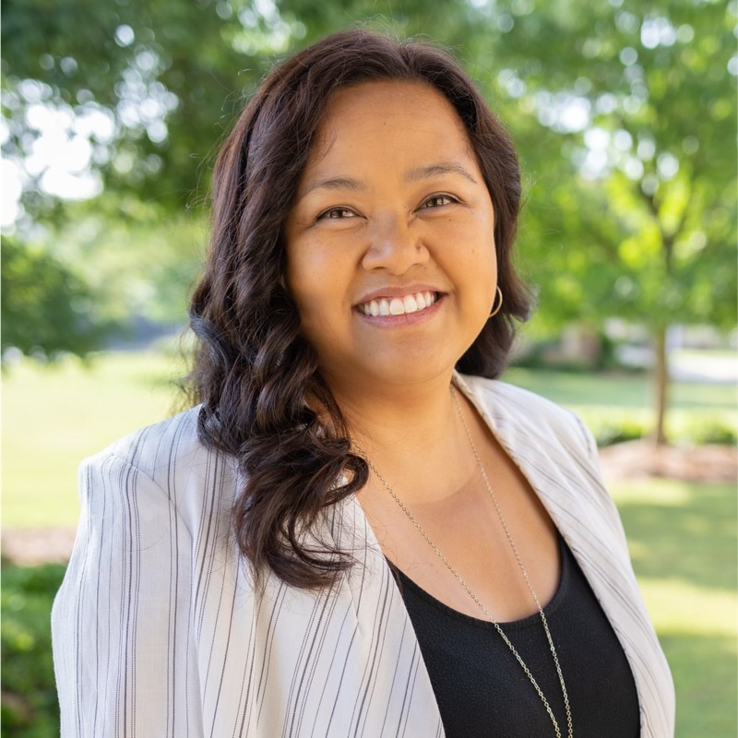

Brian Ferrell
Owner & CEO
Factor 110
Danielle Tolentino Tuason
Owner
Seniors Helping Seniors
Drew Marx
CEO
Forio

Slide 7

What’s Inside
Overview, purpose, and how
FBLA Celebrates
Connection to Competitive Events
Point Breakdown
Activity Ideas
Support Local Business Campaign
American Enterprise Day
Submission Instructions

Slide 8
Competitive Event Connections
Connections to Entrepreneurship
Middle School – Career Exploration, Exploring Agribusiness, Exploring Business Concepts, Exploring Economics, Exploring Management & Entrepreneurship
High School – Agribusiness, Business Plan, Economics, Entrepreneurship, Future Business Leader, International Business, Introduction to Business Concepts, Real Estate, Sports & Entertainment Management
Collegiate – Entrepreneurship Pitch Competition, Foundations of Economics, Foundations of Entrepreneurship, Foundations of Finance, Foundations of Management, Future Business Executive, International Business, Retail Management

Slide 9
Earn Points
Champion Chapter
Champion Chapter
Middle School
100 Points for planning one of the suggested activities
50 BONUS points for participating in the Support Local Business Campaign
50 Points for touring a business virtually or in person
High School
500 Points for planning one of the suggested activities
100 BONUS points for participating in the Support Local Business Campaign
100 Points for touring a business virtually or in person

Slide 10

Earn Points
Outstanding Chapter
Collegiate
200 points for hosting a panel of business and industry professionals
200 points for sponsoring a virtual or in-person meeting and greet networking session
100 BONUS points for participating in the Support Local Business Campaign

Slide 11
Activity Ideas
Member Engagement
School-wide Engagement
Shark Tank: Members pitch ideas to teachers, alumni, or local business leaders.
Entrepreneurship Escape Room: Solve business challenges to “unlock” success.
Elevator Pitch Night: Practice 60-second pitches.
Entrepreneur Spotlight Wall: Feature local/student entrepreneurs.
Themed Spirit Days: “Dress Like an Entrepreneur” or “Future CEO Day.”
Idea Jar: Students submit innovative ideas to be shared on social media.

Slide 12
Activity Ideas
Community & Career Connections
Digital & Creative Campaigns
Guest speakers, panel discussions, or field trips to local businesses.
Mentor-for-a-Day shadowing opportunities with entrepreneurs.
Social media Small Business Spotlight campaign.
#MyFutureBusiness Challenge: Share a dream business idea online.
Create a student-led podcast or video interview series with entrepreneurs.
Infographic contest showcasing innovative solutions.

Slide 13
American Enterprise Day
Established in 1980 by President Jimmy Carter
November 15
Each year, FBLA chapters across the country are encouraged to explore how businesses operate, recognize local entrepreneurs, and learn about the systems that support economic growth.
It’s a day for members to
Explore how business and innovation contribute to thriving communities.
Educate others about entrepreneurship and the impact of small businesses.
Engage in activities that encourage creativity, problem-solving, and leadership.

Slide 14

Support Local Business Campaign
Ways to Highlight Small Business
Social Media Push
Shop Local Challenge
Business Spotlights
Thank a Local Business
Invite a Guest Speaker

Slide 15
Support Local Business Campaign
Submission Instructions
Recognition
Save activities and submit entries through FBLA Connect Form
Form located – right side of chapter dashboard
Advisers must be logged into FBLA Connect.
Deadline: November 30
Digital Certificate of Recognition
Digital Medallion to display on chapter social media
Eligibility to have photos or projects highlighted on FBLA’s website and/or social media channels

Slide 16
Comments?
Questions?
Thoughts?

Slide 17
"I’m as proud of many of the things we haven’t done as the things we have done. Innovation is saying no to a thousand things."
Steve Jobs

